Slide 1
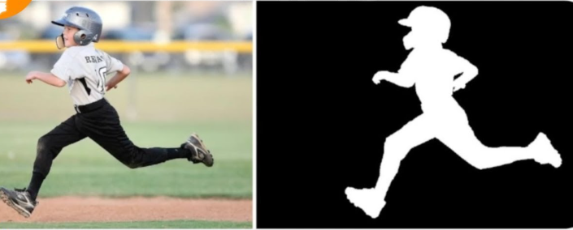
Image segmentation
Using Unet Architecture
Gajarla Sujith Kumar 00766740
Sai Hruthik Gangapuram 00764600

Slide 2
CONTENTS
1
Data Processing
2
Method/ Model
3
Experiments

Slide 3
1
Data Processing
7 steps involved in Data Processing
1. Data Collection
5. Custom dataset
2. Data Annotation
6. Data Spliting and Mini Batches
3. Class Index generation
7. RGB mask generation
4. Data Loading

Slide 4



Data collection
Firstly, we have manually captured pictures of trash bins, charger horse, benches, and water dispensers in the university surroundings, totaling 128 plus samples.

Slide 5
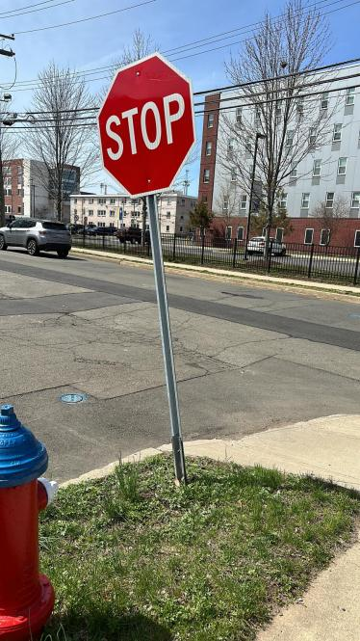

Data Annotation
Our model takes two types of images as input: one of them is the original image, and the other is a masked image, where color part is the primarily focused object in the image and black is the background in the image.
Step 1: we used an online website called remove background
(https://www.remove.bg) it takes an image as an input and returns a PNG output image containing only objects in the foreground and removes the total background.

Slide 6

Step 2:
Next, we used openCV to read the PNG image and extract the RGB channels of the image (the 3rd channel) and create a colored mask where pixels with a value greater than 0 are set to color which it belongs and pixels with a value of 0 are set to black. Create a new output image with the same dimensions as the input image but with all pixels set to black.

Slide 7
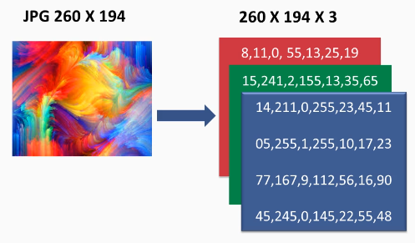
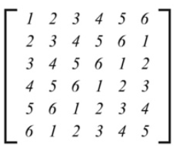

Class Index generation
260 X 194 X 1

Slide 8
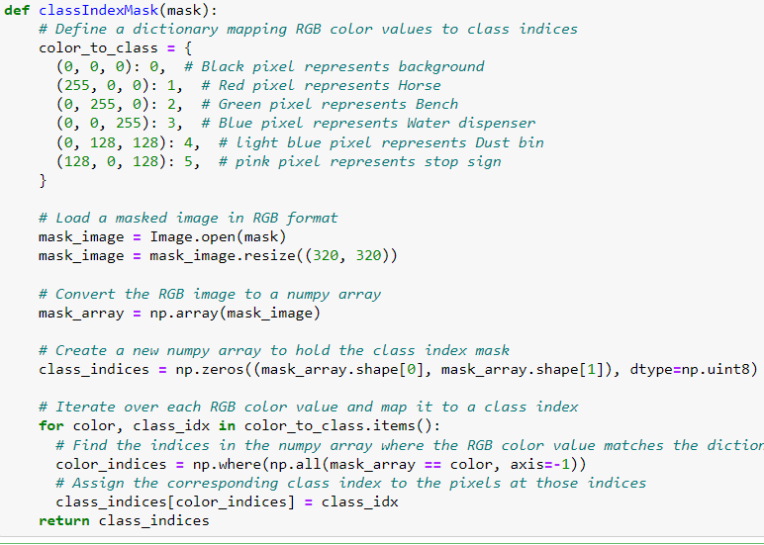

Slide 9
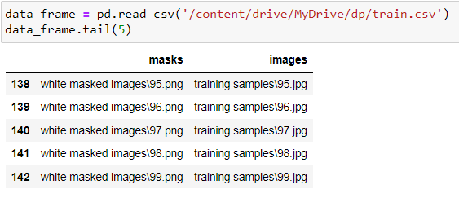
Data loading
For the loading the data, we first created an Excel sheet containing two columns, namely “images” and "masks,” each of which corresponds to their relative image paths. The images column contains all the image paths that are collected manually in the data collection part. And the “masks” column contains corresponding RBG masks that are created during the data annotation step. This file helps us load the images using their indexes instead of keeping all the images in memory.

Slide 10
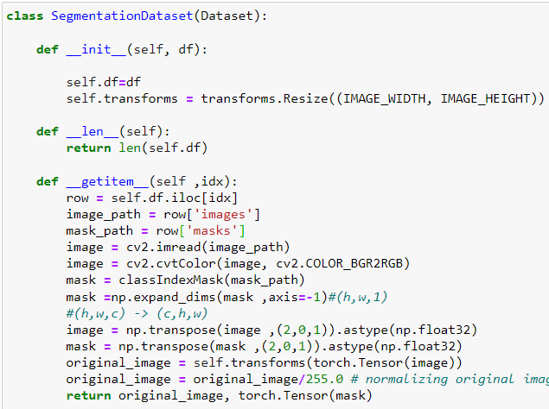
Custom Dataset
The __init__ function takes in a DataFrame df that contains the file paths to the input images and the corresponding segmentation masks. The transforms variable is set to resize the images to the specified dimensions. The __len__ function returns the number of images in the dataset, which is the length of the DataFrame. The __getitem__ function takes an index idx and returns the preprocessed Real image and its corresponding mask as tensors. It reads the input image from the file path, and resize it to (320,320) and then Normalize it later it is converted into a pytorch tensor. Parallelly the annotated mask is coverted into class index matrix by using the function declared in the above step. It then expands the mask tensor to have a single channel, and transposes both the image and mask tensors to have the shape (channel, height, width).

Slide 11
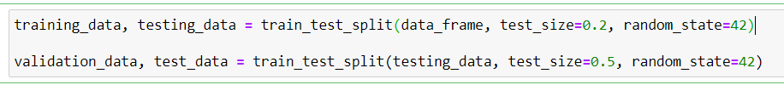
Data Spliting and Mini Batches
To split the dataset into training, testing, and validation sets, we utilized the train-test-split method from the scikit-learn library. We divided the data in an 80:10:10 ratio for training, testing, and validation sets, respectively.
Training data, validation_data, and test_data are data frames that contain information about the file paths of the images and their corresponding masks. These data frames are passed as arguments to the SegmentationDataset constructor to create the “Train data set”, valid_data_set, and test_data_set objects. These objects are used to load and pre-process the image and mask data for training, validation, and testing of the segmentation model.

Slide 12
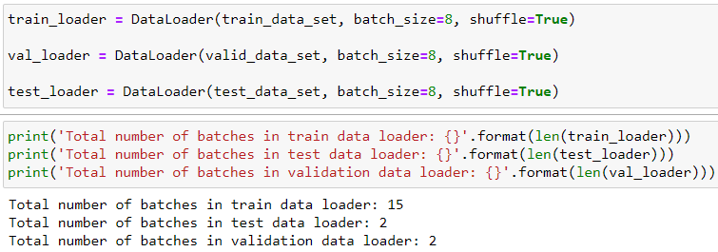
Mini Batches
train_loader loads batches of 8 samples randomly shuffled from the training dataset train_data_set. val_loader loads batches of 8 samples randomly shuffled from the validation dataset valid_data_set. test_loader loads batches of 8 samples randomly shuffled from the testing dataset test_data_set. The batch_size argument specifies the number of samples to load in each batch during training. The shuffle argument is set to True to randomly shuffle the data at the beginning of each epoch to ensure that the model learns from a diverse range of samples during training.

Slide 13
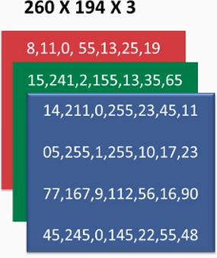
RGB mask generation
mask_to_rgb: The mask_to_rgb function takes a class Indexed matrix as input and converts it into a colored RGB image. The function uses a color map to assign colors to different class indexes. The most common color in the mask is identified and used for all non-background class indexes in the output image. If there is no predominant color, the original function is used to assign colors to each class index. The function returns an RGB image in the form of a NumPy array.
Predicted class Index
Predicted Mask

Slide 14
2
Method and Model
1. Unet Architecture
2. Unet Components
3. Pretained Model

Slide 15
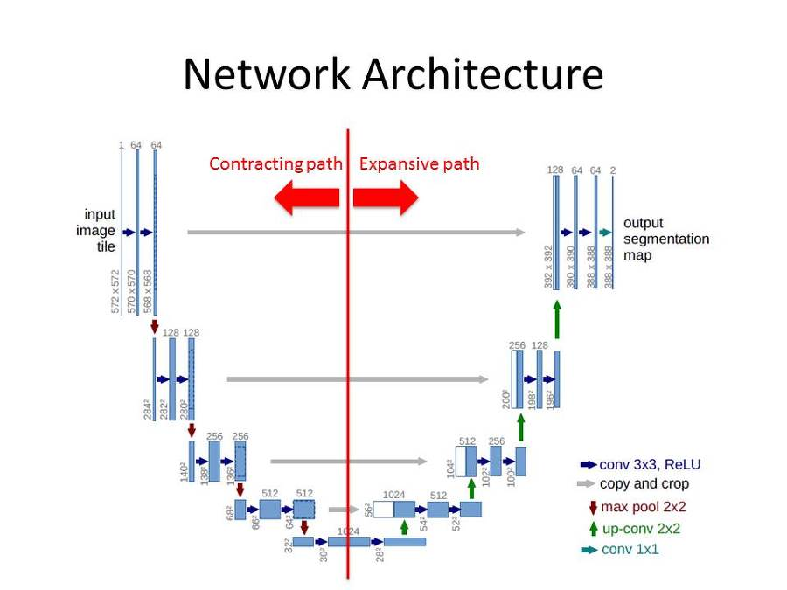
1. Unet Architecture

Slide 16
2. Unet Components
Contracting Path: The contracting path of a U-Net architecture consists of a series of convolutional layers followed by max-pooling layers. This path is responsible for reducing the spatial resolution of the input image while increasing the number of feature maps.
Bottleneck: The bottleneck of a U-Net architecture is the middle part of the "U" shape. It consists of a series of convolutional layers without any max-pooling layers, which allows the network to capture high-level features while retaining spatial information.
Expanding Path: The expanding path of a U-Net architecture consists of a series of transposed convolutional layers followed by concatenation with feature maps from the contracting path at the same level. This path is responsible for increasing the spatial resolution of the feature maps while reducing the number of feature maps
Skip Connections: The skip connections are the connections between the contracting and expanding paths of the U-Net architecture. These connections allow the network to propagate spatial information from the contracting path to the expanding path, which helps to preserve fine-grained details in the output segmentation maps.

Slide 17
Output Layer
The output layer of a U-Net architecture is a convolutional layer with a softmax activation function, which produces the final segmentation map. A softmax activation function would produce a probability distribution over the different classes or labels in the output segmentation map.
Mask to RGB: The mask_to_rgb function takes a class Indexed matrix as input and converts it into a colored RGB image. The function uses a color map to assign colors to different class indexes. The most common color in the mask is identified and used for all non-background class indexes in the output image. If there is no predominant color, the original function is used to assign colors to each class index. The function returns an RGB image in the form of a NumPy array.
Predicted class Index
Predicted Mask

Slide 18
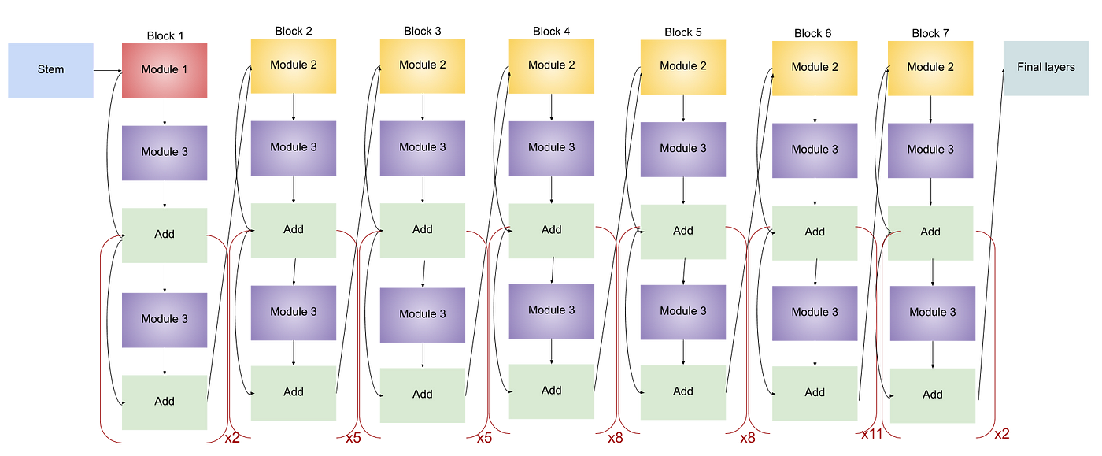
Pretrained Model efficientnet-b7

Slide 19
What happens in Modules
Convolutional layer: A 2D convolutional layer that performs a dot product between the input feature maps and a set of learnable filters. This operation extracts features from the input image.
Batch normalization: A technique that normalizes the activations of the previous layer, which can help to improve the training stability and generalization of the network.
Activation function: A non-linear function that introduces non-linearity into the network, which can help to increase the network's representational power.
Squeeze-and-excitation (SE) block: A module that learns channel-wise feature recalibration weights using a gating mechanism. This module can help to enhance the important features and suppress the less important features.
Depthwise separable convolution: A type of convolutional operation that factorizes the standard convolution into two separate operations: depthwise convolution and pointwise convolution. This operation can reduce the number of parameters and computation in the network while maintaining accuracy.

Slide 20
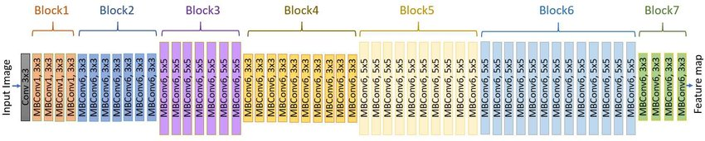
Simplified View of Architecture
MBCConv: Architecture of EfficientNetB7 with MBConv as basic building blocks. The overall architecture can be divided into seven blocks which are shown in different colours. The basic building block of the network is MBConv (mobile inverted bottleneck convolution). Each MBConvX block is shown with the corresponding filter size and the X=1 and X=6 denote the standard ReLU and ReLU6 activation function respectively

Slide 21
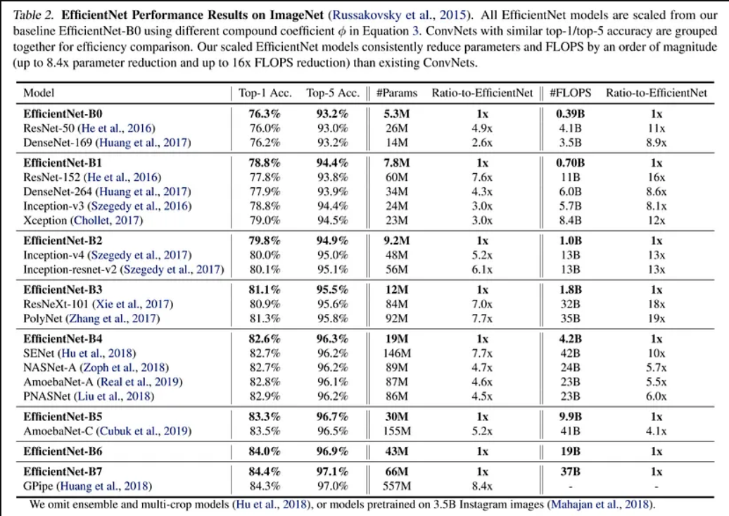
Parameters and Layers
The EfficientNet B7 architecture consists of 7 repeating blocks, with each block containing several modules. The number of modules in each block varies, with the first block having 4 modules and the last block having 14 modules.
Each module includes several operations, including a convolutional layer, batch normalization, activation function, and a squeeze-and-excitation (SE) block. The architecture also includes depthwise separable convolutions in some modules.
Based on this structure, we can estimate that the EfficientNet B7 architecture has around 220-240 individual layers. However, the exact number of layers may vary depending on how we define a "layer" and whether we include certain types of operations in the count.

Slide 22
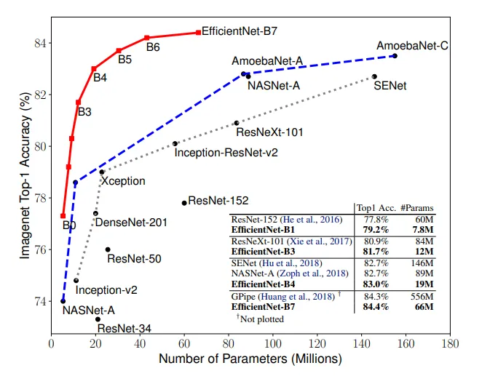
Model Accuracy

Slide 23
3
Experiments and Results
1. Hyper parameters
4. Loss vs epochs
2. Optimizer and results
3. Evaluation metrics

Slide 24
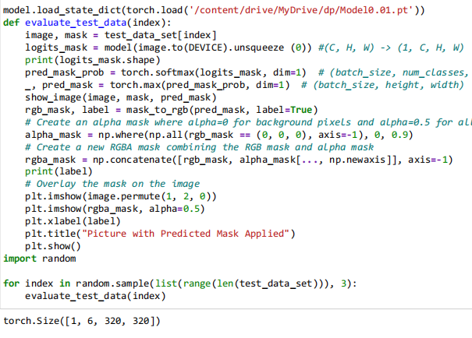
Evaluation function
The evaluate_test_data() function takes an index to select a test image from the test dataset, which return image tensor and mask tensor. Here the image tensor is passed to the best model so far tunned. Which inturns return a predicted class index mask.

Slide 25
Output Layer
The output layer of a U-Net architecture is a convolutional layer with a softmax activation function, which produces the final segmentation map. A softmax activation function would produce a probability distribution over the different classes or labels in the output segmentation map.
Mask to RGB: The mask_to_rgb function takes a class Indexed matrix as input and converts it into a colored RGB image. The function uses a color map to assign colors to different class indexes. The most common color in the mask is identified and used for all non-background class indexes in the output image. If there is no predominant color, the original function is used to assign colors to each class index. The function returns an RGB image in the form of a NumPy array.
Predicted class Index
Predicted Mask

Slide 26
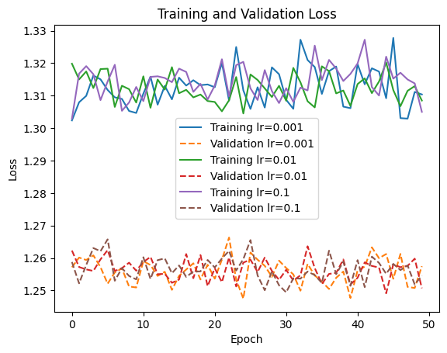
Hyper parameters
1. Learning rates = [0.001, 0.01, 0.1]
2. epochs = 50
3. loss function = = nn.CrossEntropyLoss()
4. momentum = 0.9 (fixed)
5. Optimizer = ADAM
Issues
Overfitting: If the model is too complex, it may overfit the training data, leading to poor generalization performance and bouncing loss. In this case, you could try reducing the model complexity or regularizing the model with techniques such as dropout or weight decay.
Insufficient training data: If the model is too complex and the training data is too small, the model may not be able to learn meaningful representations from the data. In this case, you could try increasing the amount of training data or using data augmentation techniques to generate more training examples.

Slide 27
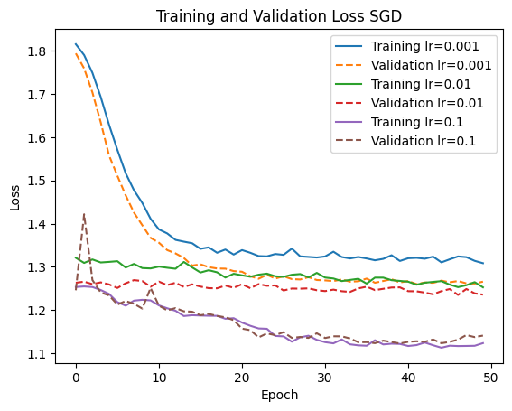
SGD Optimizer
1. Learning rates = [0.001, 0.01, 0.1]
2. epochs = 50
3. loss function = = nn.CrossEntropyLoss()
4. momentum = 0.9 (fixed)
5. Optimizer = SGD
SGD was showing better results if you compare it with ADAM. so we dicided to stick with this model for further experiments on test data set.

Slide 28
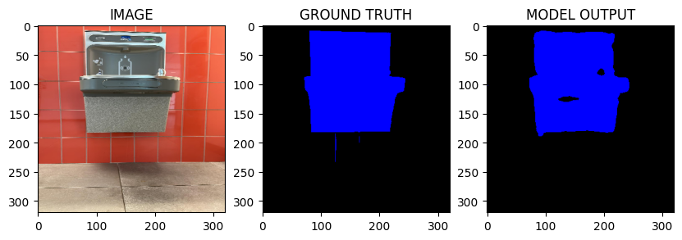
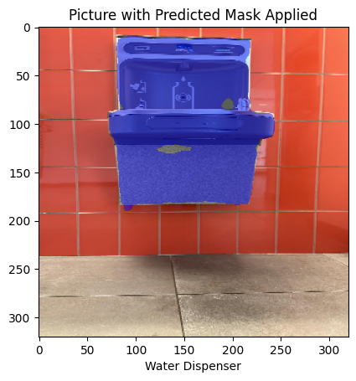
Results

Slide 29
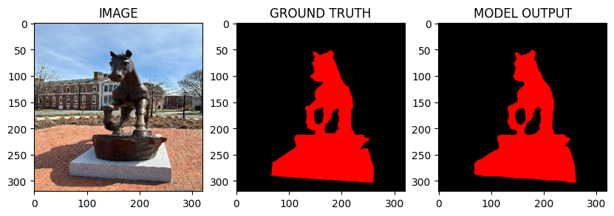
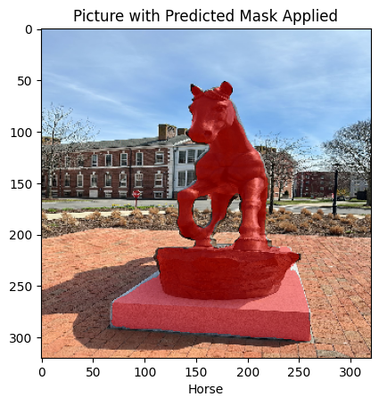

Slide 30
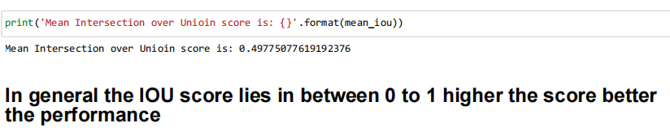
Intersection over Union
Intersection over Union (IoU): This is a widely used metric to evaluate the performance of a segmentation model. It measures the overlap between the predicted segmentation and the ground truth segmentation. IoU is defined as the area of intersection divided by the area of union between the predicted and ground truth segmentations.
Calculate the area of intersection between the predicted and ground truth regions as the area of overlap between the two regions:
Intersection Area = (Width of Overlap) x (Height of Overlap)
Calculate the area of union between the predicted and ground truth regions as the sum of the areas of the two regions minus the area of intersection:
Union Area = (Area of Predicted Region) + (Area of Ground Truth Region) - (Intersection Area)
Calculate IOU as the ratio of the intersection area to the union area:
IOU = Intersection Area / Union Area

Slide 31
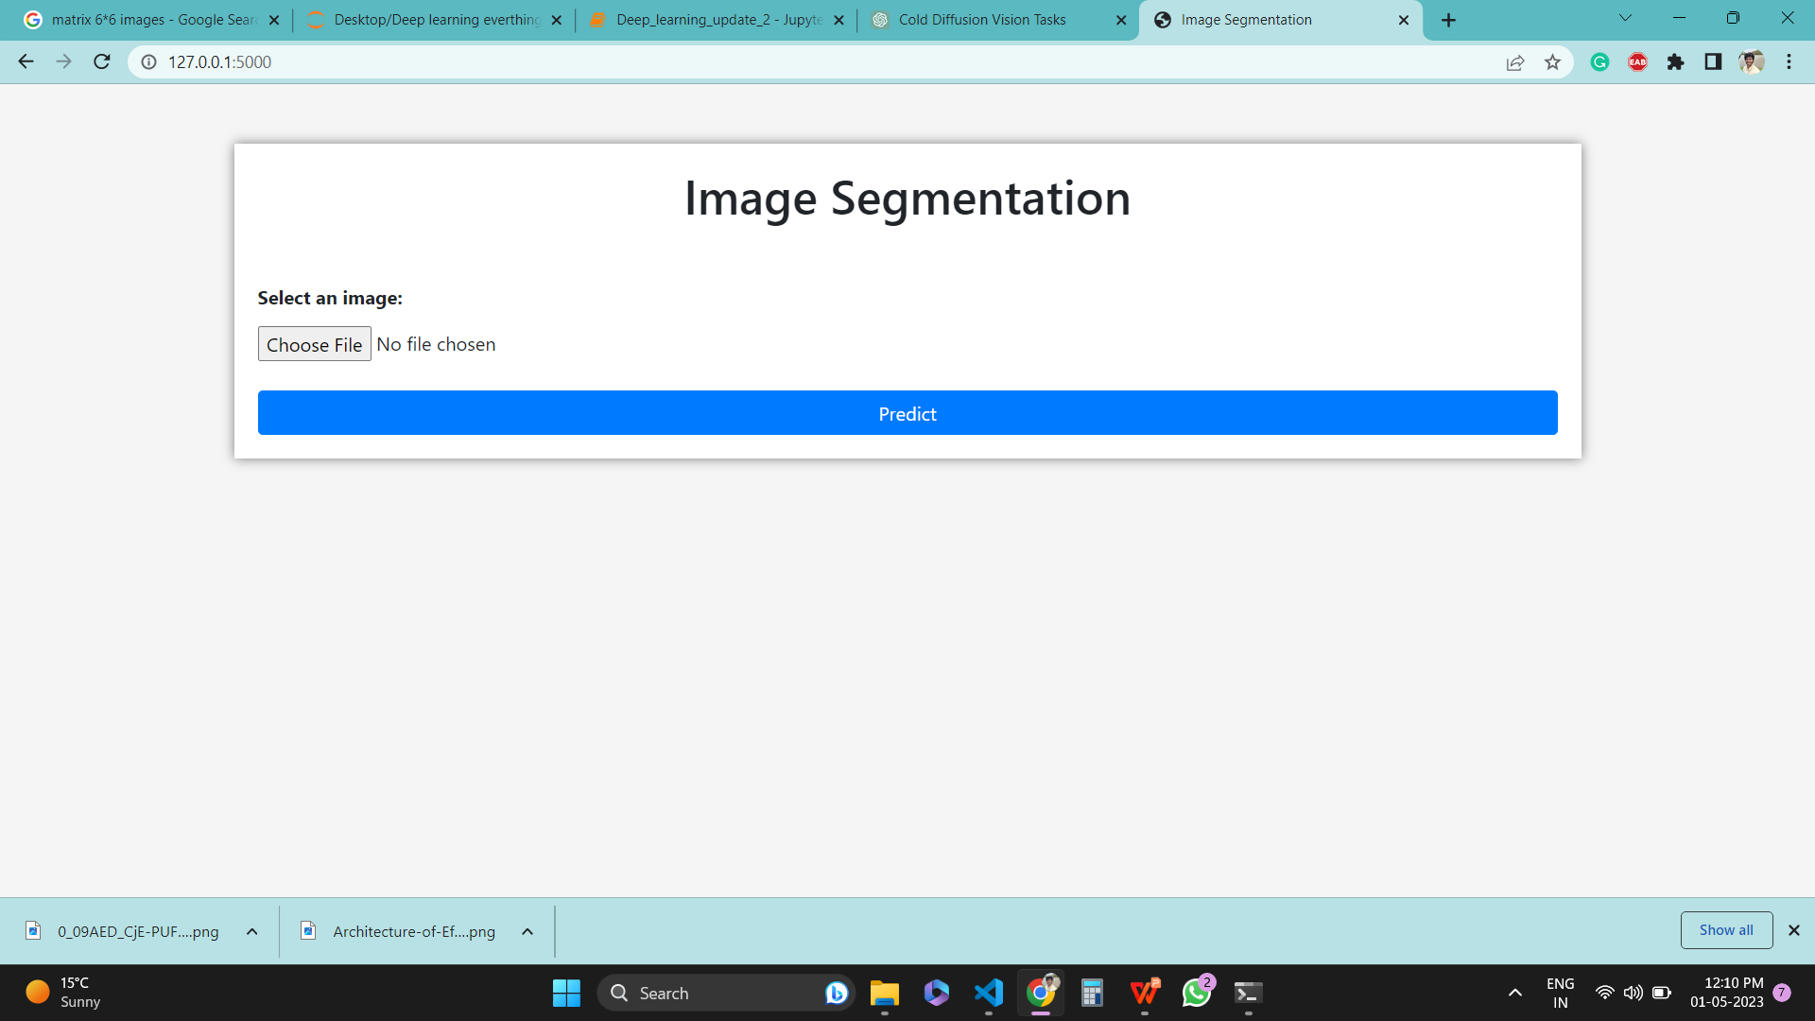
Deployment

Slide 32
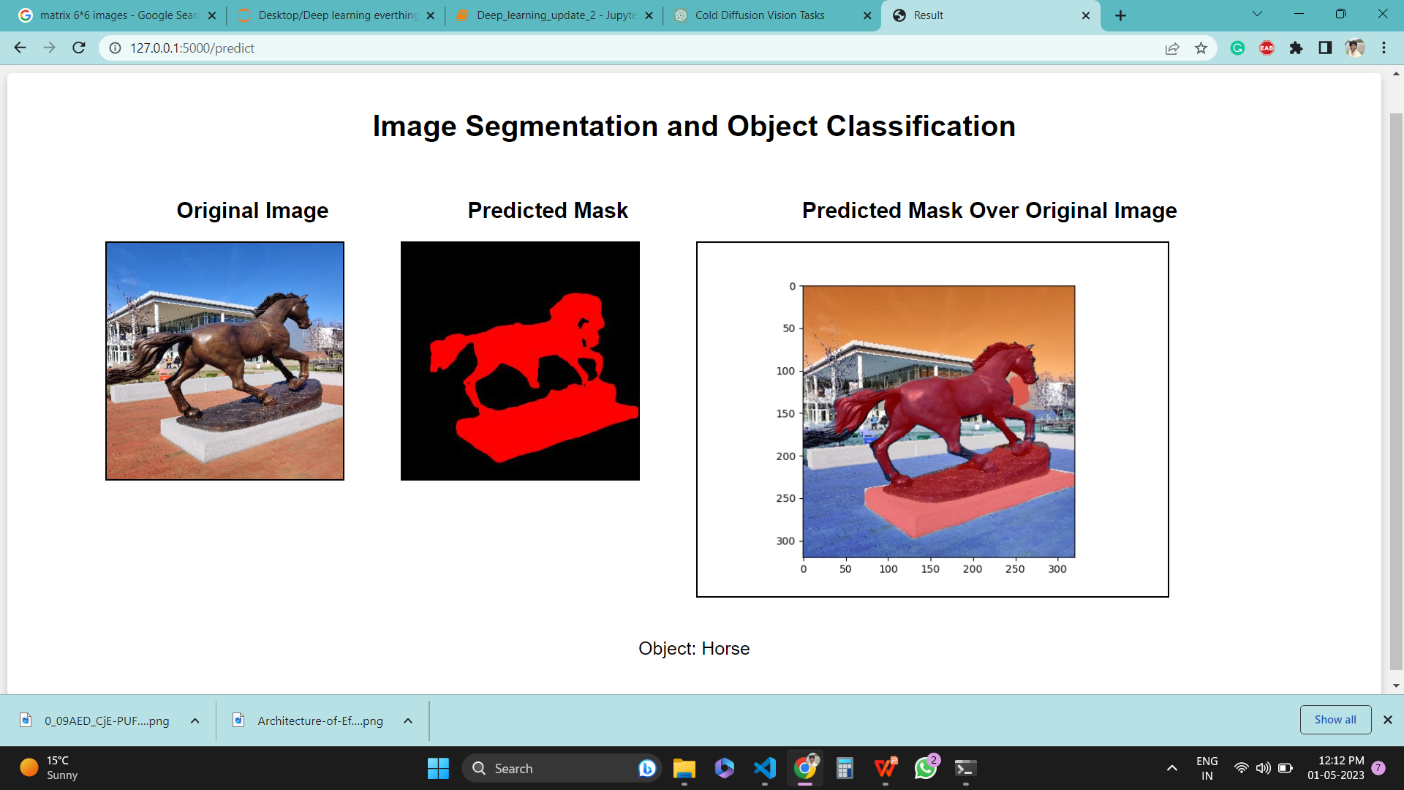

Slide 33
THANK YOU

